Slide 1
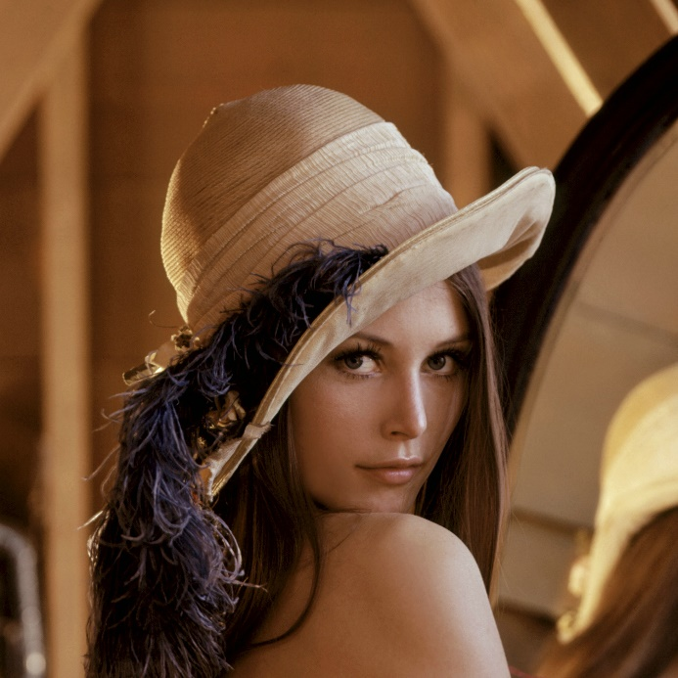


Visión por computador en la nueva era de la Inteligencia Artificial y el Deep Learning
Computer vision in the new era of Artificial Intelligence and Deep Learning
Rubén Usamentiaga*, Alberto Fernándezº
* University of Oviedo
º TSK
Gijón (Spain)
5 – 16 April 2021
https://github.com/albertofernandezvillan/computer-vision-and-deep-learning-course

Slide 2

Scikit-learn
Introducing scikit-learn for classification, regression and clustering
scikit_learn_introduction_classification.ipynb
scikit_learn_introduction_regression.ipynb
k_means_clustering_sklearn.ipynb
scikit_learn_introduction_classification.ipynb
scikit_learn_introduction_regression.ipynb
k_means_clustering_sklearn.ipynb
https://github.com/albertofernandezvillan/computer-vision-and-deep-learning-course
Notes:
Empezar con el ejemplo del tren en la pizarra

Slide 3
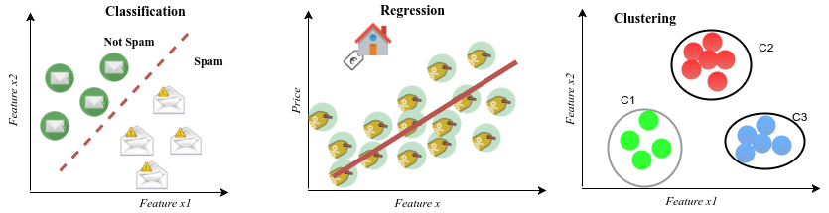
supervised vs unsupervised learning
Supervised
Unsupervised
Spam filtering
House price estimation
Customers clustering
Classification: predicting a label
Classification uses supervised learning techniques to find the relationship between the features and the assigned label (e.g. spam/no spam)
Regression: predicting a quantity
Regression uses supervised learning techniques to learn a mapping function from the features to a continuous output variable. A regression problem requires the prediction of a quantity. All houses have a price.
Clustering: assigning a cluster
Customers are grouped into different categories based on their purchasing behaviour, but the unsupervised learning algorithm has no information about the labels (or classes) associated with each sample

Slide 4
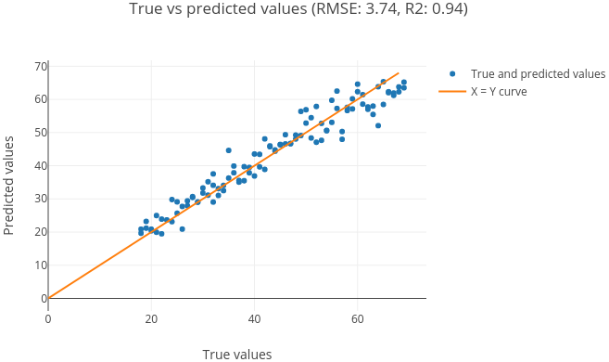
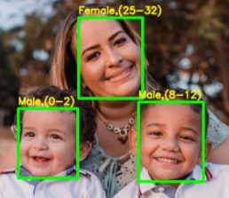
Classification vs regression
In some cases, it is possible to convert a regression problem to a classification problem. For example, the age to be predicted could be converted into discrete buckets. Age in a continuous range between [0 and 100] could be converted into:
Class 0: 0 - 2
Class 1: 3 - 8
Class 2: 8 – 12
….

Slide 5
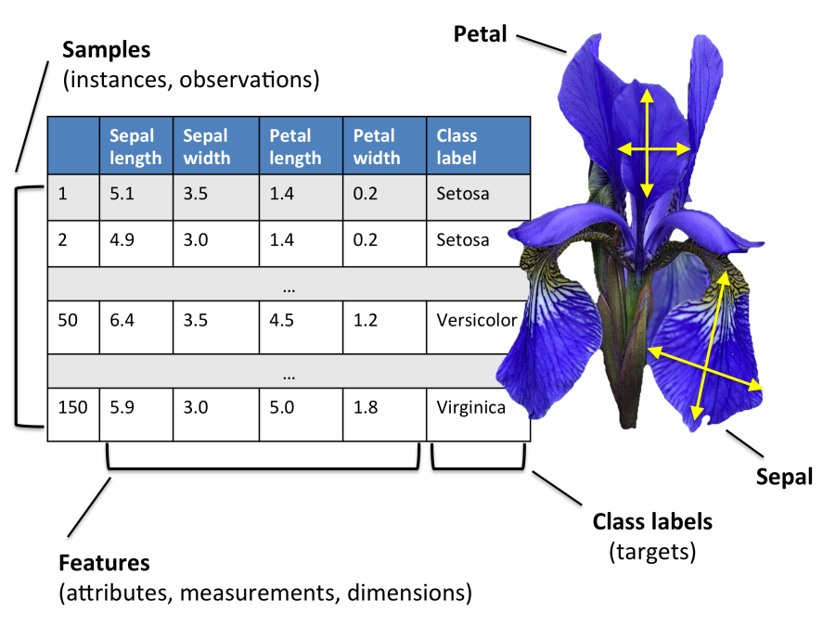
Scikit-learn for classification: dataset
from sklearn.datasets import load_iris
iris = load_iris()
x = iris.data
y = iris.target
feature_names = iris.feature_names
target_names = iris.target_names
x.shape: (150,4)
y.shape: (150,1)
Feature names: '['sepal length (cm)', 'sepal width (cm)', 'petal length (cm)', 'petal width (cm)']'
Target names: '['setosa' 'versicolor' 'virginica']'
As we have three classes, this is a three-class classification problem, because our task here is to classify each sample in one of the three classes (the species of Iris).

Slide 6
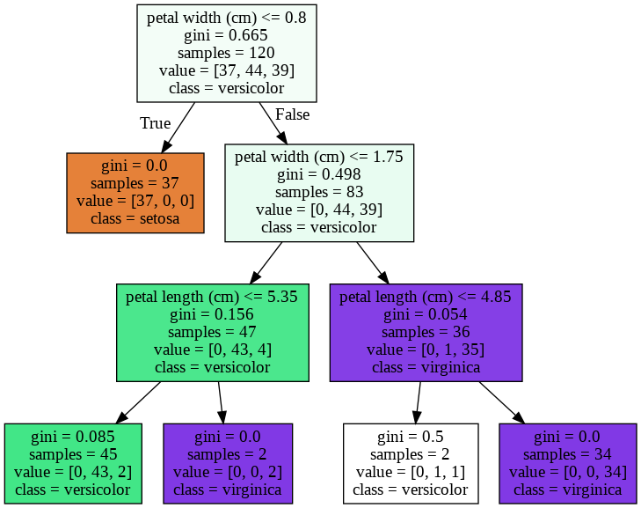
Scikit-learn for classification: training
Split training and test sets
from sklearn.model_selection import train_test_split
# Split the dataset for training and testing:
x_train, x_test, y_train, y_test = train_test_split(x, y, test_size=0.2, random_state=123)
x train shape: '(120, 4)'
x test shape: '(30, 4)'
Training (fit)
from sklearn import tree
# Create the decision tree classifier
tree_classifier=tree.DecisionTreeClassifier(random_state=0, max_depth=3)
# We can train the model with fit function:
tree_classifier.fit(x_train,y_train)

Slide 7
Making predictions using the trained model
sepal length of 5 cm
sepal width of 5 cm
petal length of 5 cm
petal width of 0.7999 cm.
new_sample = np.array([[5, 5, 5, 0.7999]])
# Predict the class for this new sample:
predicted_class = tree_classifier.predict(new_sample)
pred_class = predicted_class[0]
class_name = iris.target_names[pred_class]
Model persistence
from joblib import dump
dump(tree_classifier, 'iris_tree_classifier.joblib')
from joblib import load
tree_classifier_iris = load('iris_tree_classifier.joblib')

Slide 8
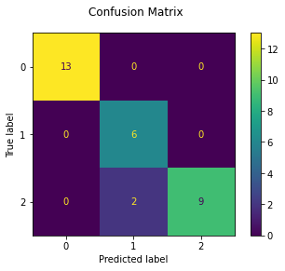
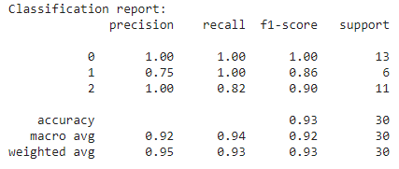
Measuring the accuracy of the trained model
# 1. After training, the model is ready to make predictions:
tree_predictions = tree_classifier.predict(x_test)
# 2. Get the comparisons (True/False) for each one:
comparisons = (tree_predictions == y_test)
print("comparisons array: \n '{}'".format(comparisons))
# 3. Calculate the accuracy using np.mean():
my_accuracy = np.mean(comparisons)
print("The accuracy of the model is: '{}'".format(my_accuracy))
import sklearn.metrics as metrics
metrics.accuracy_score(y_test, tree_predictions)
metrics.classification_report(y_test, tree_predictions)
metrics.plot_confusion_matrix(tree_classifier, x_test, y_test)

Slide 9
The importance of features in Machine Learning
Feature names: '['sepal length (cm)', 'sepal width (cm)', 'petal length (cm)', 'petal width (cm)']'
Target names: '['setosa' 'versicolor' 'virginica']'
Based on the obtained results we can conclude that 4 features are enough to describe each sample
This leads to the following question:
How to find “good features” describing my objects to be classified?

Slide 10
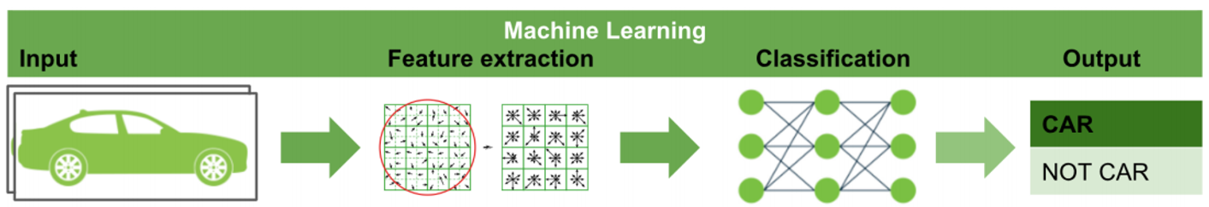
The importance of features in Machine Learning
Feature engineering is the process of using domain knowledge to extract features from raw data. These features can be used to improve the performance of machine learning algorithms

Slide 11
The importance of features in Machine Learning
Example of feature extractors in computer vision
Local binary patterns (LBP) is a feature extraction algorithm.
LBP is a type of visual descriptor used for classification in computer vision
The histogram of oriented gradients (HOG) is a feature descriptor used in computer vision and image processing for the purpose of object detection

Slide 12
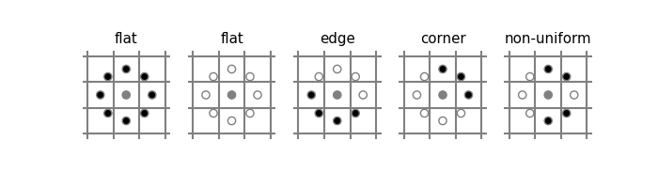
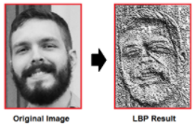
Local Binary Pattern (LBP)
https://scikit-image.org/docs/dev/auto_examples/features_detection/plot_local_binary_pattern.html
LBP looks at points surrounding a central point and tests whether the surrounding points are greater than or less than the central point (i.e. gives a binary result)
radius = 3
n_points = 8 * radius
METHOD = 'uniform‘
lbp = local_binary_pattern(image, n_points, radius, METHOD)

Slide 13
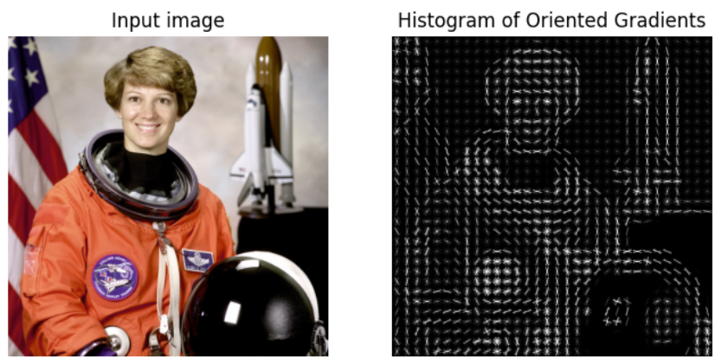
Histogram of oriented gradients (HOG)
https://scikit-image.org/docs/dev/auto_examples/features_detection/plot_hog.html
from skimage.feature import hog
fd, hog_image = hog(image, orientations=8, pixels_per_cell=(16, 16),
cells_per_block=(1, 1), visualize=True, multichannel=True)
(n_blocks_row, n_blocks_col, n_cells_row, n_cells_col, n_orient) ndarray
In this case: 8192 features

Slide 14
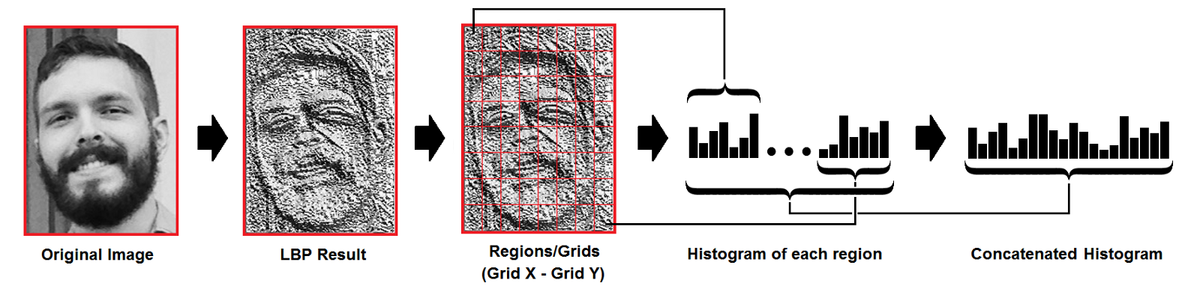
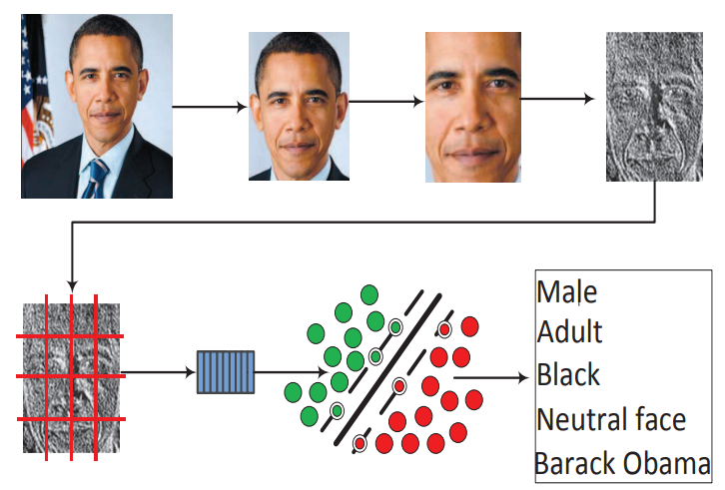
Example: using LBP for face encoding
For efficient face representation, extracted features should retain also spatial information. Hence, the facial image is divided into m regions
features for each image
Each concatenated histogram (the features) is labelled according the purpose of the classifier:
For gender recognition: male (0)/female (1)
For emotion recognition: neutral (0)/happy (1)/sad (2)/…
Therefore we have N samples in our dataset:
Each sample corresponds to an image
Each sample has features (histogram) and a label (class)
Finally, a classifier (SVM, KNN,…) is trained/tested using all the training/testing instances

Slide 15
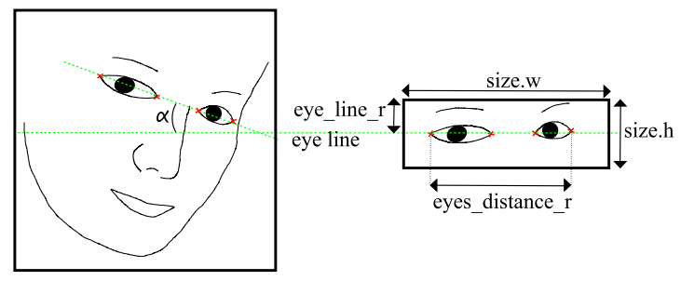
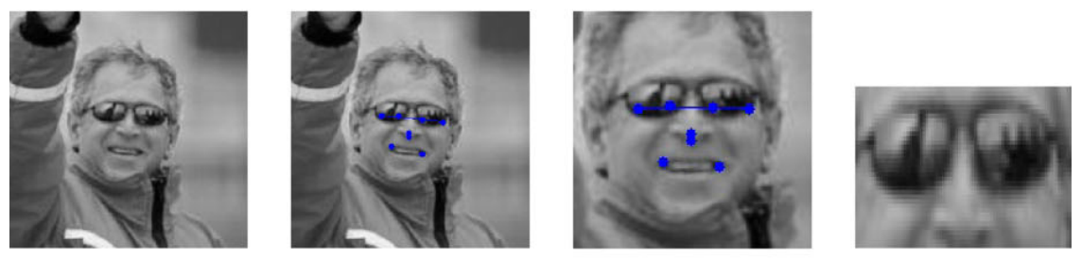
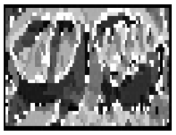
Example for glasses detection
This region is encoded using 56 values (if uniform LBP and a neighborhood of 8 pixels )
Uniform LBP patterns produces M values (labels):
M=59 labels for a neighborhood of 8 pixels and produces M=256 labels for standard LBP. Additionally, for the 16 neighborhoods, the numbers are M=243 and M=65,536, respectively.
The total length of the histogram will be XxYxM, where X and Y are the number of division in both the width and the height of the input image (to retain also spatial information)

Slide 16
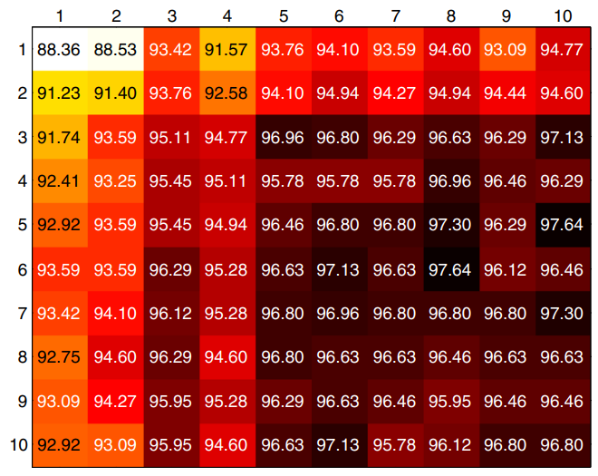
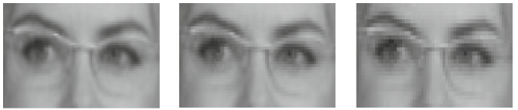
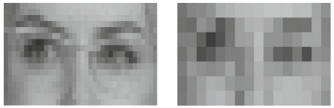
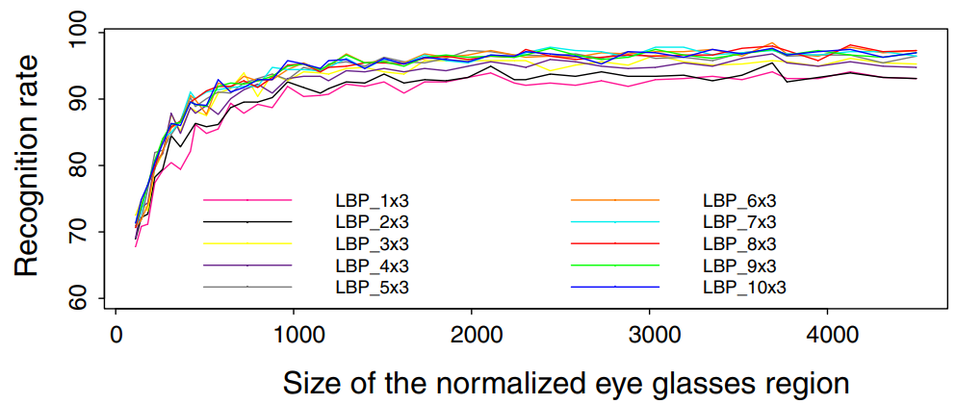
Example for glasses detection
Fernández, A., García, R., Usamentiaga, R., & Casado, R. (2015). Glasses detection on real images based on robust alignment. Machine Vision and Applications, 26(4), 519-531.
Recognition rates as a function of the number of regions
Results varying from the maximum to the minimum size of the normalized eye glasses region
When looking for the optimal number of regions, it is observed that the changes in the number of regions may cause big difference in the length of the feature vector, but the performance is not necessarily affected significantly.

Slide 17
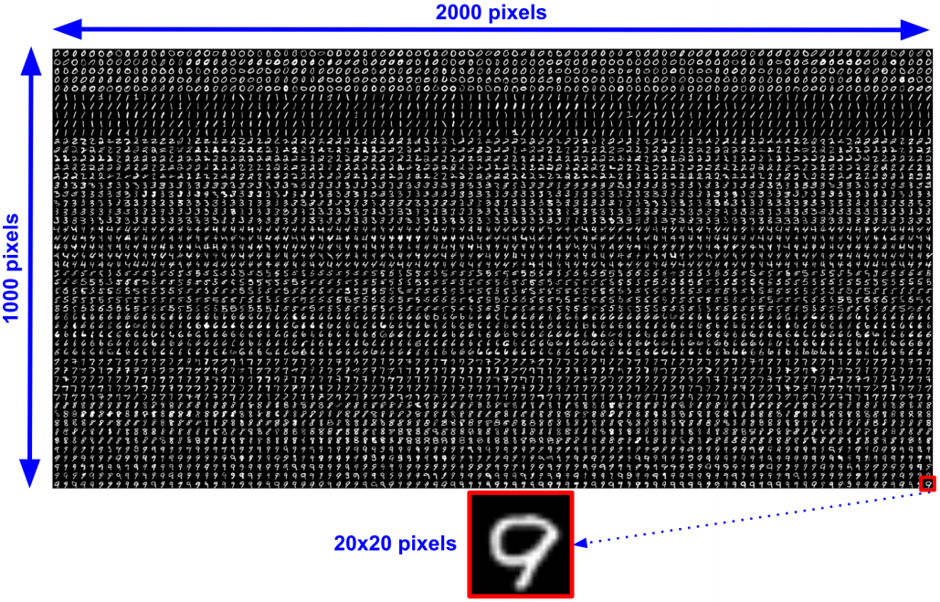
HOG for handwritten digits recognition
Dataset: https://github.com/PacktPublishing/Mastering-OpenCV-4-with-Python/blob/master/Chapter10/01-chapter-content/digits.png

Slide 18
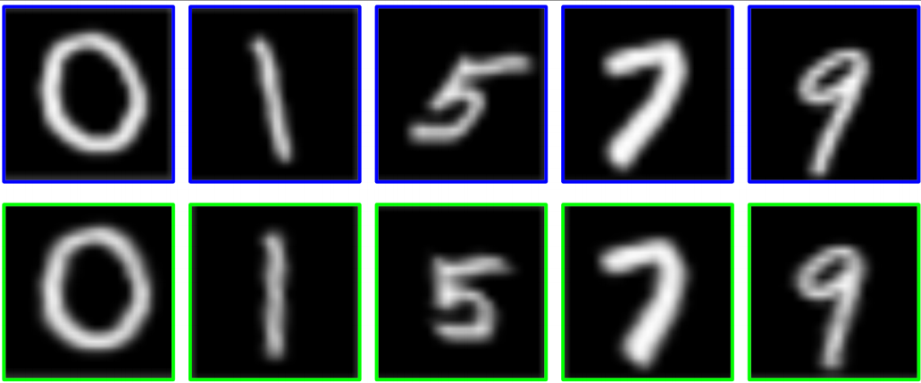
HOG for handwritten digits recognition
Handwritten digits recognition using SVM and HoG features:
https://github.com/PacktPublishing/Mastering-OpenCV-4-with-Python/blob/master/Chapter10/01-chapter-content/svm_handwritten_digits_recognition_preprocessing_hog.py
Handwritten digits recognition using SVM and HoG features with pre-processing of the images. A grid-search on C and gamma is also carried out.
https://github.com/PacktPublishing/Mastering-OpenCV-4-with-Python/blob/master/Chapter10/01-chapter-content/svm_handwritten_digits_recognition_preprocessing_hog_c_gamma.py
Handwritten digits recognition using KNN and HoG features and varying both k and the number of training/testing images with pre-processing of the images
https://github.com/PacktPublishing/Mastering-OpenCV-4-with-Python/blob/master/Chapter10/01-chapter-content/knn_handwritten_digits_recognition_k_training_testing_preprocessing_hog.py
Pre-processing = deskew (in this specific case)
Note: Indicated examples use OpenCV Machine Learning module (cv2.ml) and not scikit-learn

Slide 19
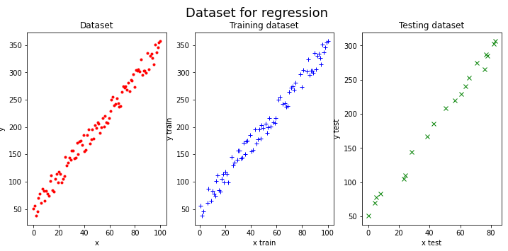
Scikit-learn for regression: dataset

Slide 20
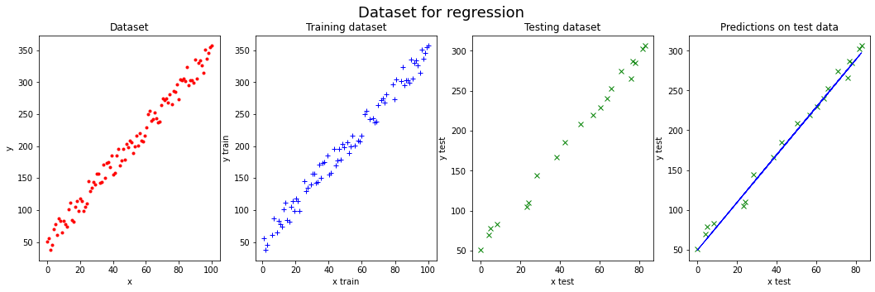
Scikit-learn for regression: training and testing
from sklearn import linear_model
# Create linear regression object:
model = linear_model.LinearRegression()
# Train the model using the training sets:
model.fit(x_train, y_train)
# The coefficients and the intercept factor:
print("Coefficients: {}".format(model.coef_))
print("Intercept: {}".format(model.intercept_))
from sklearn.metrics import mean_squared_error, r2_score
# Make predictions using the testing set
y_preds = model.predict(x_test)
# Model score:
model.score(x_test, y_test))
# The mean squared error (mse):
mean_squared_error(y_test, y_preds)
r2_score(y_test, y_preds)
Coefficients: [[2.99811861]]
Intercept: [49.14094108]

Slide 21
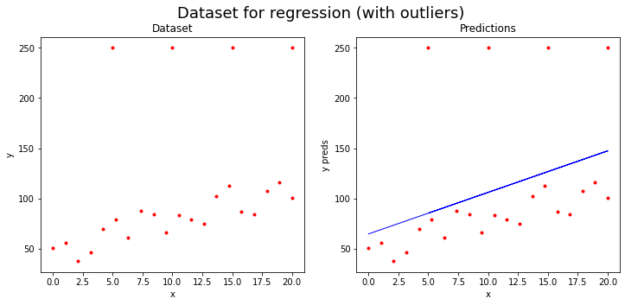
Scikit-learn for regression: dataset with outliers
linear_model.LinearRegression estimator is heavily influenced by the outliers

Slide 22
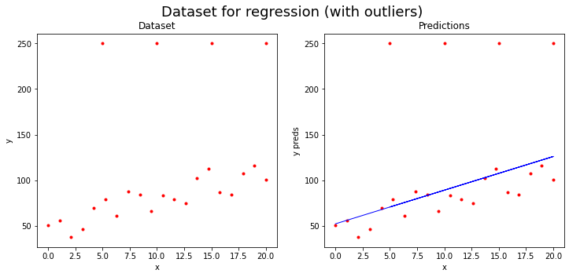
Scikit-learn for regression: dataset with outliers
linear_model.HuberRegressor is robust to outliers
The parameter epsilon controls the number of samples that should be classified as outliers. The smaller the epsilon, the more robust it is to outliers. greater than 1.0, default=1.35
HuberRegressor(epsilon=2.0)

Slide 23
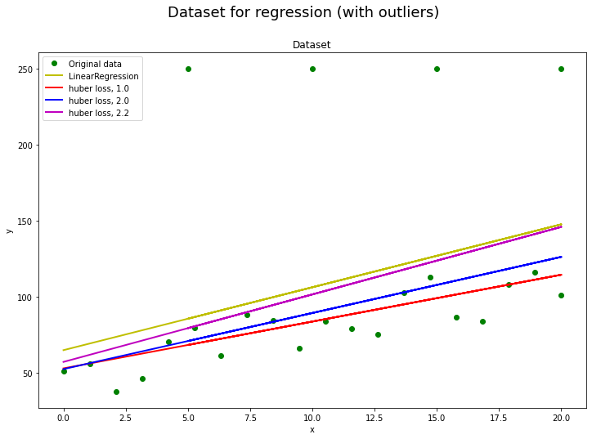
Scikit-learn for regression: dataset with outliers
HuberRegressor estimator is less influenced by the outliers. Moreover, as the parameter epsilon is increased for the HuberRegressor estimator, the obtained results get closer to the results obtained with the LinearRegression estimator.

Slide 24
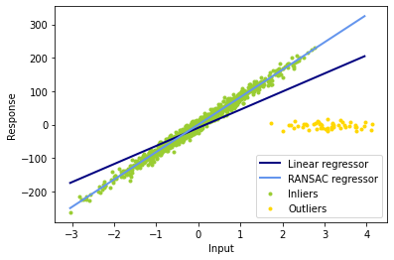
Scikit-learn for regression: dataset with outliers
Robust linear model estimation using RANSAC
# Robustly fit linear model with RANSAC algorithm
ransac = linear_model.RANSACRegressor()
ransac.fit(X, y)
inlier_mask = ransac.inlier_mask_
outlier_mask = np.logical_not(inlier_mask)
Boolean mask of inliers classified as True.
plt.scatter(X[inlier_mask], y[inlier_mask], color='yellowgreen', marker='.', label='Inliers')
plt.scatter(X[outlier_mask], y[outlier_mask], color='gold', marker='.', label='Outliers')

Slide 25
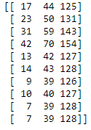
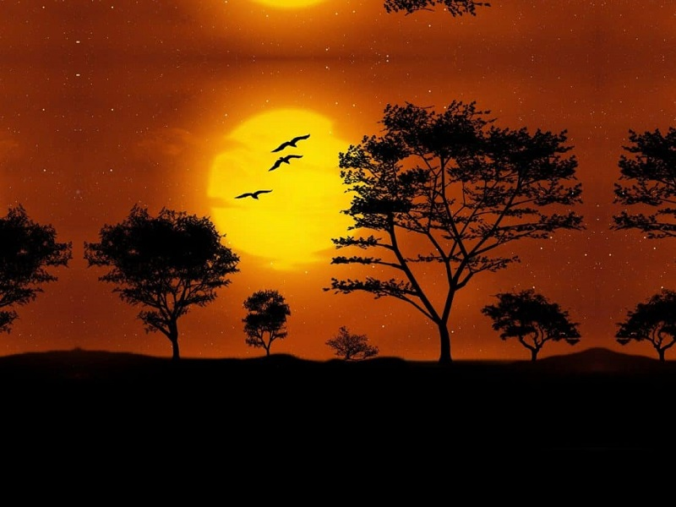
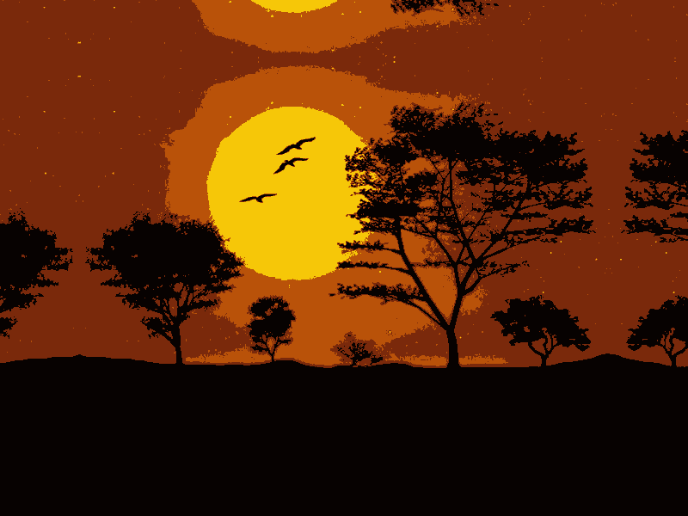
K-Means clustering for color quantization in scikit-learn
img = cv2.imread("landscape.jpg")
img = img.reshape((img.shape[1]*img.shape[0], 3))
kmeans = KMeans(n_clusters=NUMBER_CLUSTERS)
kmeans.fit(img)
centroids = kmeans.cluster_centers_
centroids = np.uint8(centroids)
labels = kmeans.labels_
result = centroids[labels]
result = result.reshape(img_shape)
[1 2 7]
[ 8 199 246]
0 0 0 3 0 0 0 0 0 0 0 0 0 0 0 0 0 0 0 0 0 0 0 0 0 0 0 0
0 0 0 0 0 0 0 0 0 0 0 0 0 0 0 0 0 0 0 0 0 0 0 0 0 0 0 0 3 3 0 0 0 0 0 0 0 0 0 0 0 0 0 0 0 0 0 0 0 0 0 0 0 0 0 0
[ 11 41 122]
[ 9 82 185]
Centroids are in the form of BGR triplets

Slide 26
Scikit-learn
Introducing scikit-learn for classification, regression and clustering
https://github.com/albertofernandezvillan/computer-vision-and-deep-learning-course
Notes:
Empezar con el ejemplo del tren en la pizarra

